Slide 1
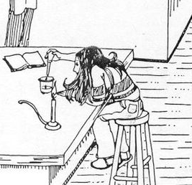
Daily Review
Follow the steps we have been using to write a safety rule on your whiteboard for one hazard in this picture.
Step 1: Identify the hazard
Step 2: Work out how the hazard could cause harm
Step 3: Write a rule that will protect you from the hazard (make it positive if possible)

Slide 2
Safety Poster Assessment Task Year 7 Science

Slide 3
Learning Objective
CFU
What are we going to do today?
Design a poster showing one important safety rule for the Science lab.
Activate Prior Knowledge
On your white board, write two rules that are there to keep you safe. They can be for the Science classroom or in the community.

Slide 4
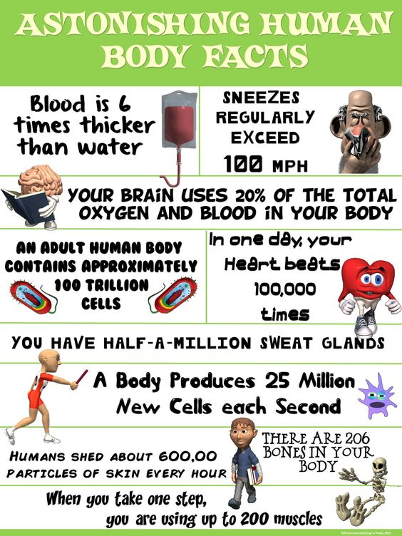
Concept Development
CFU
Explain to the person next to you why this is an effective poster.
A poster is an effective way of displaying information. They should be eye-catching and informative.
Effective posters have common features:
A title (often, but not always at the top)
Small amounts of information in clear sections
Easy to read writing style and size
Images related to the topic
Enough colour to make it interesting, but not too much to make it distracting
Spaced out so it fills the whole page

Slide 5
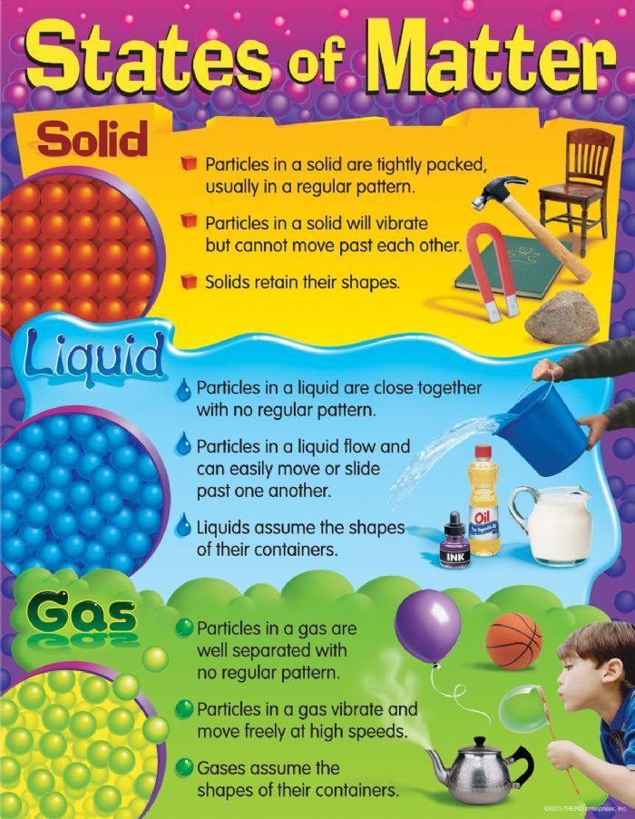
Concept Development
CFU
Explain to the person next to you why this is an effective poster.
A poster is an effective way of displaying information.
They should be eye-catching and informative.
Effective posters have common features:
A title (often, but not always at the top)
Small amounts of information in clear sections
Easy to read writing style and size
Images related to the topic
Enough colour to make it interesting, but not too much to make it distracting
Spaced out so it fills the whole page

Slide 6
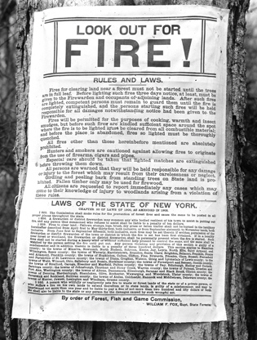
Concept Development
CFU
Explain to the person next to you why this is an ineffective poster.
A poster is an effective way of displaying information.
They should be eye-catching and informative.
Effective posters have common features:
A title (often, but not always at the top)
Small amounts of information in clear sections
Easy to read writing style and size
Images related to the topic
Enough colour to make it interesting, but not too much to make it distracting
Spaced out so it fills the whole page

Slide 7

Concept Development
CFU
Explain to the person next to you why this is an ineffective poster.
A poster is an effective way of displaying information.
They should be eye-catching and informative.
Effective posters have common features:
A title (often, but not always at the top)
Small amounts of information in clear sections
Easy to read writing style and size
Images related to the topic
Enough colour to make it interesting, but not too much to make it distracting
Spaced out so it fills the whole page

Slide 8
Skill Development/Guided Practice
Steps for designing your poster:
Step 1: Choose a short Science safety rule.
Step 2: Write your rule on your poster, large enough to see from a distance.
Step 3: Draw an illustration that relates to your rule.
Step 4: Make sure your poster is brightly coloured so it is easy to see.
Step 5: Make sure your poster is neat (rub out any pencil lines, outline in black texta etc.)
Vocabulary
Illustration: picture or image

Slide 9
Skill Development/Guided Practice
Steps for designing your poster
Step 1: Choose a short Science safety rule.
Step 2: Write your rule on your poster, large enough to see from a distance.
Step 3: Draw an illustration that relates to your rule.
Step 4: Make sure your poster is brightly coloured so it is easy to see.
Step 5: Make sure your poster is neat (rub out any pencil lines, outline in black texta etc.)
Always clean
up spills
Vocabulary
Illustration: picture or image

Slide 10

Skill Development/Guided Practice
Steps for designing your poster
Step 1: Choose a short Science safety rule.
Step 2: Write your rule on your poster, large enough to see from a distance.
Step 3: Draw an illustration that relates to your rule.
Step 4: Make sure your poster is brightly coloured so it is easy to see.
Step 5: Make sure your poster is neat (rub out any pencil lines, outline in black texta etc.)
Always clean
up spills
Vocabulary
Illustration: picture or image

Slide 11

Skill Development/Guided Practice
Steps for designing your poster
Step 1: Choose a short Science safety rule.
Step 2: Write your rule on your poster, large enough to see from a distance.
Step 3: Draw an illustration that relates to your rule.
Step 4: Make sure your poster is brightly coloured so it is easy to see.
Step 5: Make sure your poster is neat (rub out any pencil lines, outline in black texta etc.)
Always clean
up spills
Vocabulary
Illustration: picture or image

Slide 12

Skill Closure
On your white board, name two features that posters have in common.
Skill Closure
Tell the person next to you why this is an effective poster, then write three reasons on your whiteboard.

Slide 13
Relevance
Creating a safety poster and displaying it will help you remember to work safely in the Science classroom.
This will also make our room more colourful.

Slide 14
Independent Practice
This poster will be ASSESSED and contribute towards your Semester 1 grade.
You will have the remainder of this lesson and the first half of next lesson to complete your Safety Poster. You will then have 20 minutes next lesson to write a descriptive paragraph explaining your Safety Poster design.
Steps for designing your poster:
Step 1: Choose a short Science safety rule.
Step 2: Write your rule on your poster, large enough to see from a distance.
Step 3: Draw an illustration that relates to your rule.
Step 4: Make sure your poster is brightly coloured so it is easy to see.
Step 5: Make sure your poster is neat (rub out any pencil lines, outline in black texta etc.)
Start designing your poster.

